Slide 1
Pauli Exclusion Principle

Slide 2
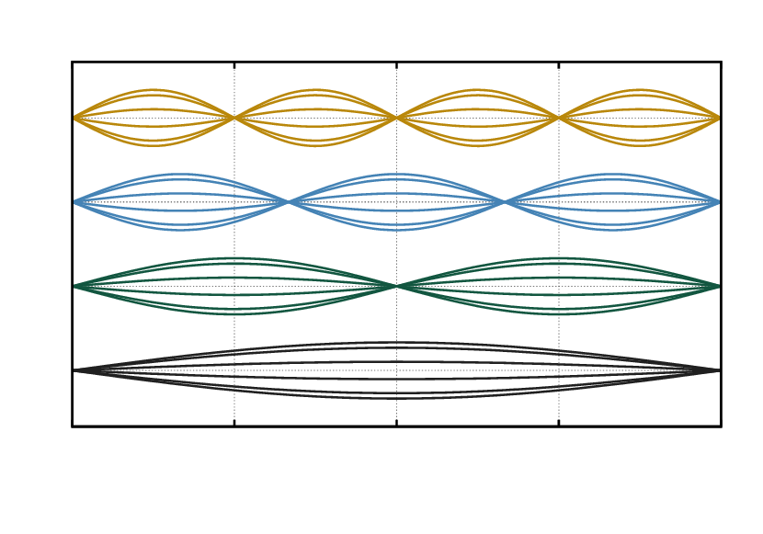
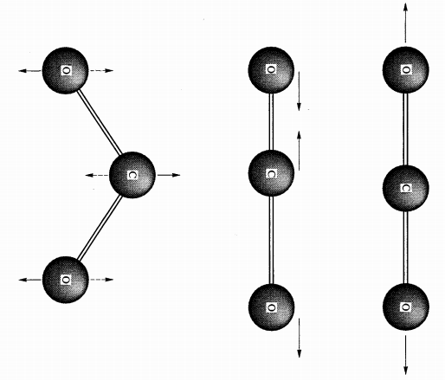
Symmetry sometimes makes things easier
Vibrating string: the middle point of the string must be a node or an antinode
Vibrational modes of a molecule

Slide 3

Sometimes symmetry makes physics harder
Microscopic physics is described by a “wavefunction” Ψ.
|Ψ|² tells you the probability of a configuration
Identical particles have “exchange symmetry”
>> Ψ(x₁,x₂, …) = Ψ(x₂,x₁, …) boson
>> Ψ(x₁,x₂, …) = - Ψ(x₂,x₁, …) fermion

Slide 4
Exchange symmetry
Weakly interacting bosons can have a wavefunction made of just one single-particle state
Ψ(x₁,x₂,x₃,… ) = f(x₁) f(x₂) f(x₃) …
Fermions have to be more complicated, because
Ψ(x₁,x₂, … ) = 0 whenever x₁ = x₂.
Informally, each fermion must be doing something different or be at a different place.
This is not an interaction. It is a symmetry.

Slide 5
Who’s a fermion?
Electrons
Protons
Neutrons
Neutrinos
Nuclei with odd mass number
Atoms with an odd number of electrons + protons + neutrons
Bosons: photons , and nuclei and atoms with an even number of particles

Slide 6
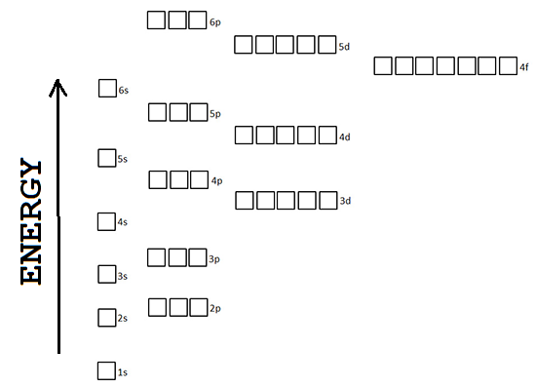
A familiar example
The single-particle states of an atom
Each electron goes in a different state – the lowest energy available.
A complication: there are two kinds of electrons.
This explains a lot about the chemical properties of different elements.

Slide 7
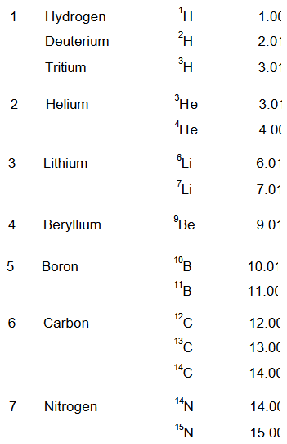
Stable isotopes
Chemically identical elements with different atomic weights.
What is the rule that explains which combinations of charge and mass are allowed?
Nuclei are made of protons and neutrons.

Slide 8
Stable isotopes
Chemically identical elements with different atomic weights.
What is the rule that explains which combinations of charge and mass are allowed?
E = mc²
→low mass means low energy

Slide 9
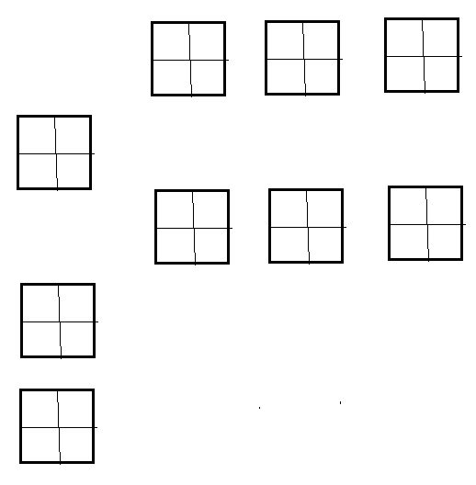
Stable isotopes
There’s a similar diagram!
But now there are two kinds of fermions involved:
Proton has charge
Neutron does not
But their masses are almost the same.
Neutrons can turn into protons by radioactive decay when this decreases the atomic mass.

Slide 10
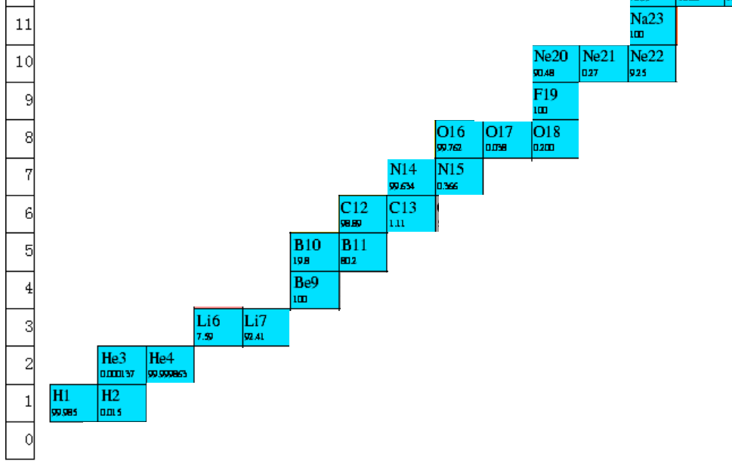
Isotope chart

Slide 11
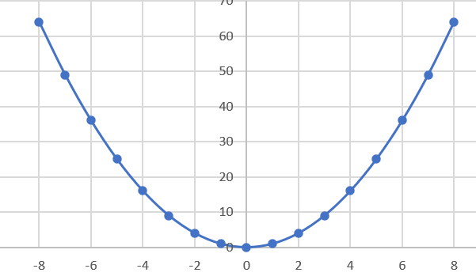
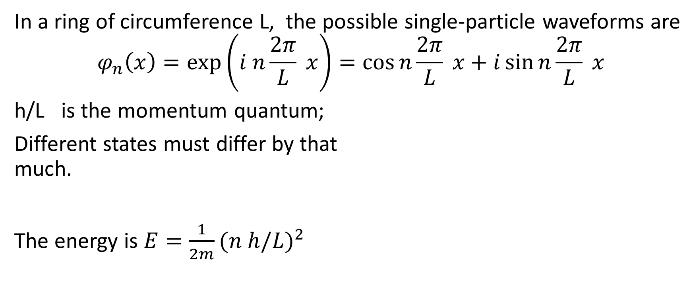
One dimensional fermion gas
In a ring of circumference L, the possible single-particle waveforms are
$$φ_{n}\left(x\right)=\exp\left(i n\frac{2π}{L} x\right)=\cos{n\frac{2π}{L} x+i\sin{n\frac{2π}{L} x}}$$
h/L is the momentum quantum;
Different states must differ by that much.
The energy is $E=\frac{1}{2m}{(n h/L)}^{2}$

Slide 12
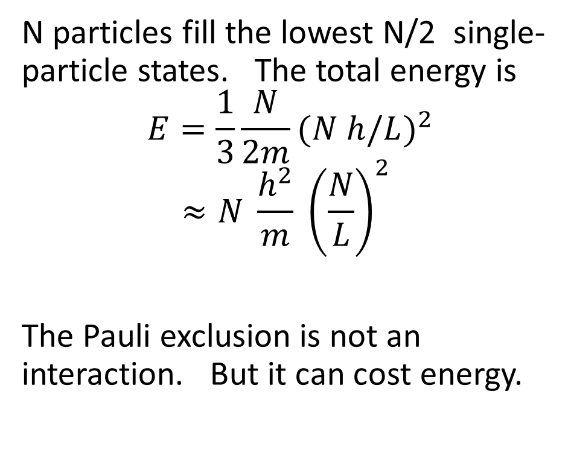
Total energy
N particles fill the lowest N/2 single-particle states. The total energy is
$$E=\frac{1}{3}\frac{N}{2m}{(N h/L)}^{2}$$
$$≈N \frac{h^{2}}{m} {\left(\frac{N}{L}\right)}^{2}$$
The Pauli exclusion is not an interaction. But it can cost energy.

Slide 13
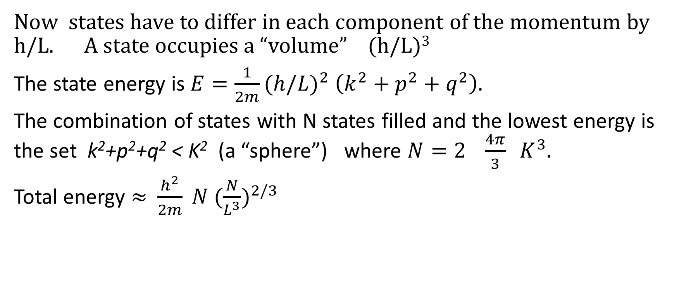
Three-dimensional fermion gas
Now states have to differ in each component of the momentum by h/L. A state occupies a “volume” (h/L)³
The state energy is $E=\frac{1}{2m}{(h/L)}^{2} \left(k^{2}+p^{2}+q^{2}\right).$
The combination of states with N states filled and the lowest energy is the set k²+p²+q² < K² (a “sphere”) where $N=2 \frac{4π}{3} K^{3}.$
Total energy ≈$\frac{h^{2}}{2m} N {(\frac{N}{L^{3}})}^{2/3}$

Slide 14
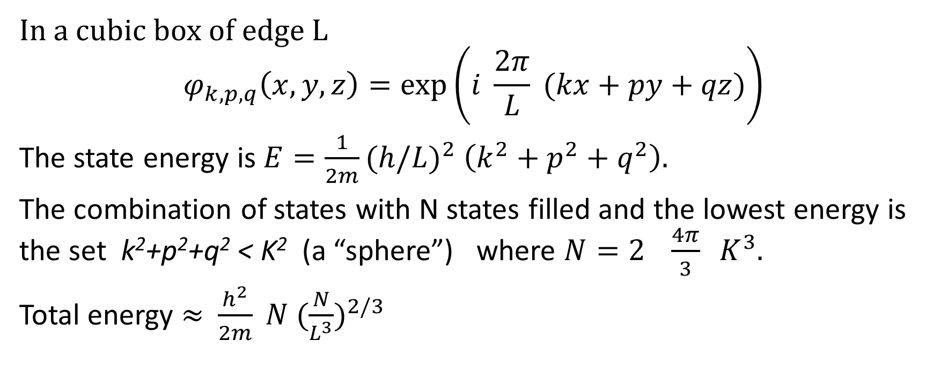
Three-dimensional fermion gas
In a cubic box of edge L
$$φ_{k,p,q}\left(x,y,z\right)=\exp\left(i \frac{2π}{L} (kx+py+qz)\right)$$
The state energy is $E=\frac{1}{2m}{(h/L)}^{2} \left(k^{2}+p^{2}+q^{2}\right).$
The combination of states with N states filled and the lowest energy is the set k²+p²+q² < K² (a “sphere”) where $N=2 \frac{4π}{3} K^{3}.$
Total energy ≈$\frac{h^{2}}{2m} N {(\frac{N}{L^{3}})}^{2/3}$

Slide 15
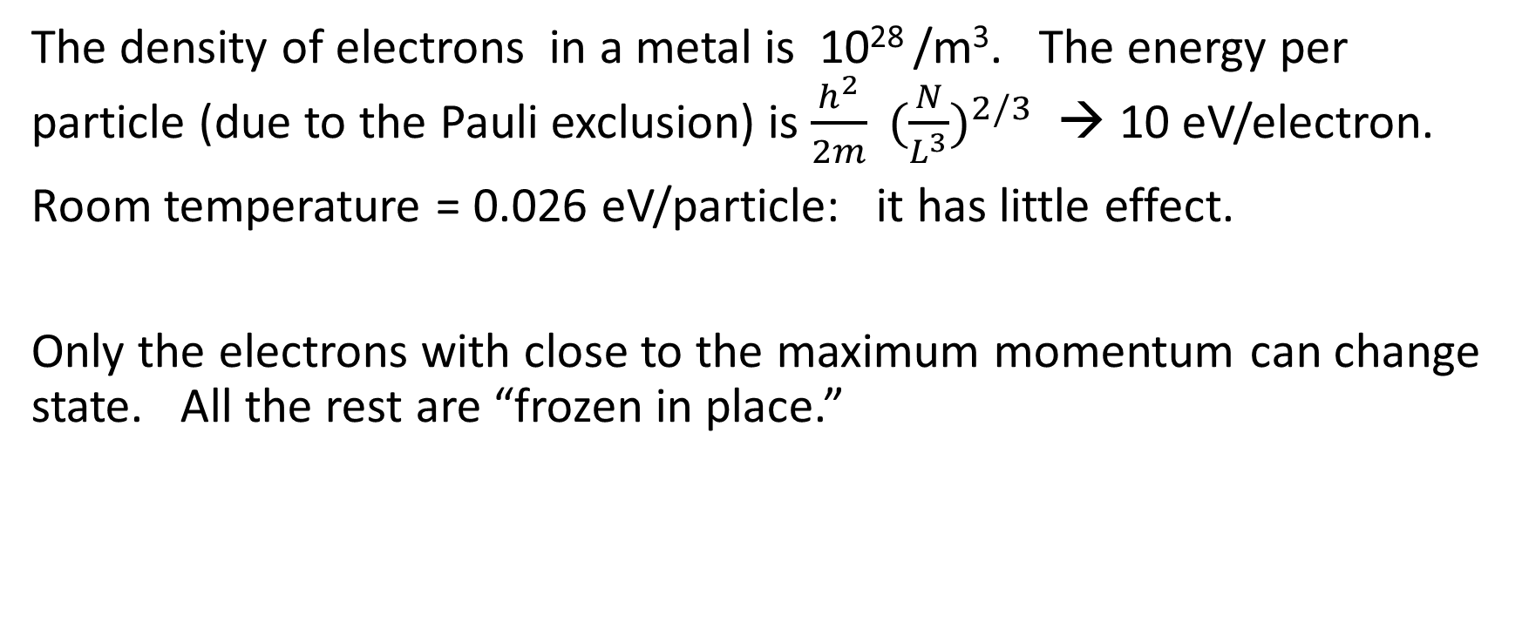
Metals
The density of electrons in a metal is 10²⁸ /m³. The energy per particle (due to the Pauli exclusion) is $\frac{h^{2}}{2m} {(\frac{N}{L^{3}})}^{2/3}$ → 10 eV/electron.
Room temperature = 0.026 eV/particle: it has little effect.
Only the electrons with close to the maximum momentum can change state. All the rest are “frozen in place.”

Slide 16
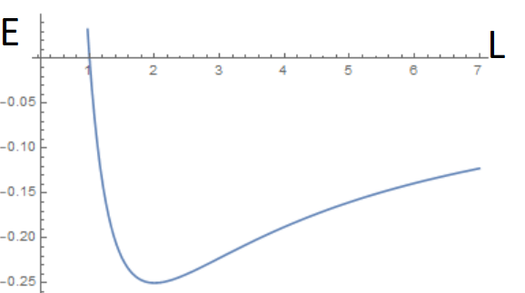

Minimum size for a star
A star is a gas of protons and electrons – both fermions. Ignoring thermal energy,
Total energy $≈ \frac{h^{2}}{2m} N {(\frac{N}{L^{3}})}^{2/3}$ - $G \frac{N^{2}M^{2}}{L}$
This has a minimum as a function of the size L, for L ≈ N^{-1/3}

Slide 17
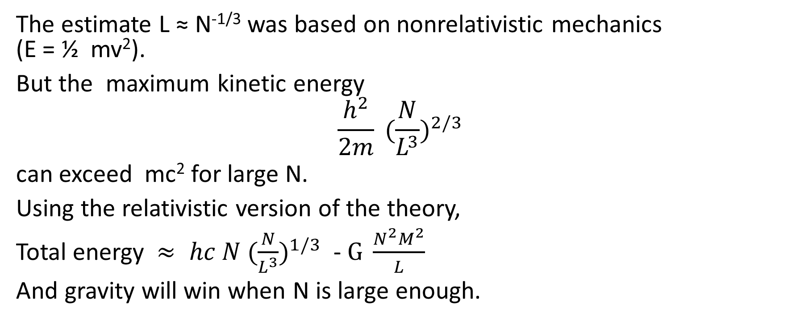
Supernova
The estimate L ≈ N^{-1/3} was based on nonrelativistic mechanics (E = ½ mv²).
But the maximum kinetic energy
$$\frac{h^{2}}{2m} {(\frac{N}{L^{3}})}^{2/3}$$
can exceed mc² for large N.
Using the relativistic version of the theory,
Total energy $≈ hc N {(\frac{N}{L^{3}})}^{1/3}$ - $G \frac{N^{2}M^{2}}{L}$
And gravity will win when N is large enough.

Slide 18

Neutron star
The electrons and protons combine to make neutrons. These are also fermions. The theory for the minimum star size can be used again.
Total energy $≈ \frac{h^{2}}{2m} N {(\frac{N}{L^{3}})}^{2/3}$ - $G \frac{N^{2}M^{2}}{L}$

Slide 19
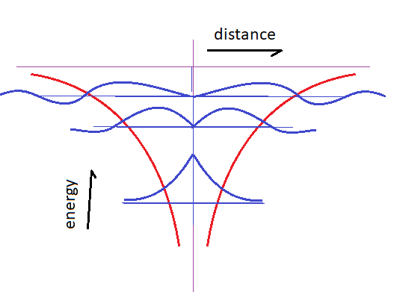
Atomic wavefunctions
The electron mostly stays in the low potential area, but there is a small probability that it is outside of it.

Slide 20
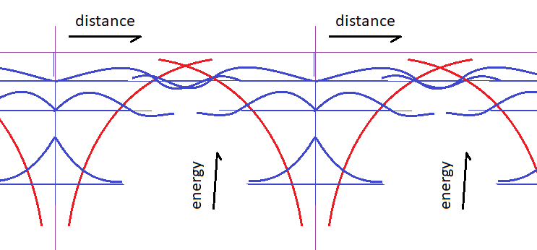
Crystal wavefunctions
The wavefunctions for neighboring atoms overlap, allowing the electrons to move from one to another.
The energy levels broaden into “bands.”

Slide 21
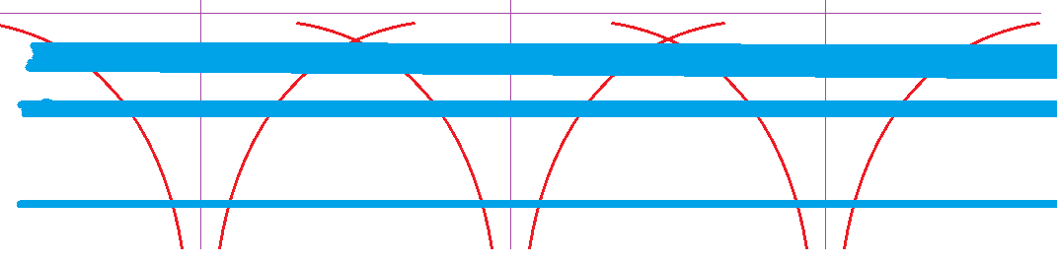
State counting
The total number of states stays the same as a level becomes a band.
In an N-atom crystal, a single state of one atom becomes a band that can hold 2N electrons.
The bands are wider when the wavefunctions overlap more.

Slide 22
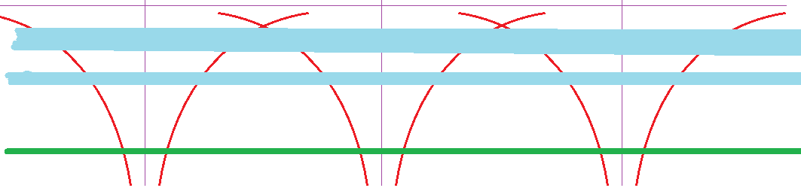
State counting
If there are two electrons per atom, the first level is filled.
This is an insulator. The electrons can’t respond to an electric field or temperature.

Slide 23
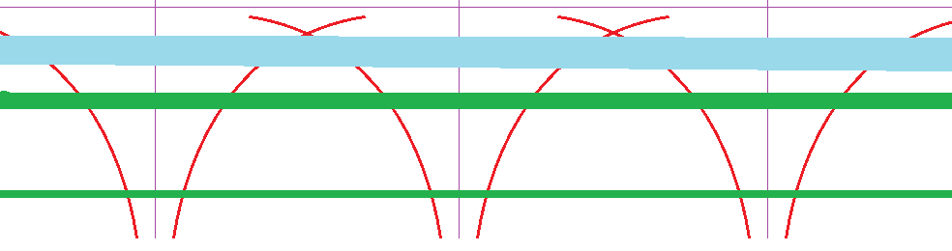
Semiconductors
When the energy difference between bands is small, thermal excitation can put a few electrons in the upper band, leaving a few “holes” in the lower band.
An electric field causes the electrons to move one way, and the holes to move the other. This is a semiconductor.

Slide 24
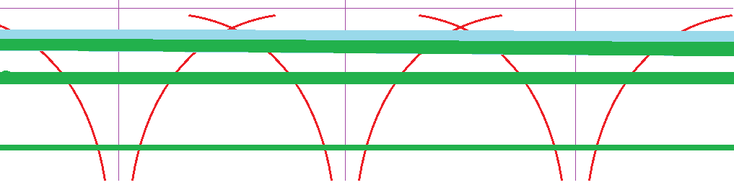
Conductors
Partially filled bands and overlapping bands give conductors.

Slide 25
Insulators
The single-particle wave functions for the low-energy states are small in size. Electrons in these states don’t move from atom to atom very often. The electron state becomes an electron “band” – a range of possible state energies.
For N atoms, there are N states. 2N electrons will fill all of them.
Widely spaced atoms with an even number of electrons are likely to form insulators.

Slide 26
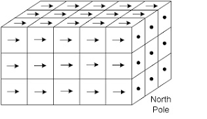
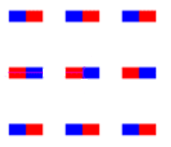
Magnetism
The magnetic field of a magnet is due to the magnetic fields of the spinning electrons, which are all spinning in the same direction.
Thinking of the electrons as tiny magnets, they have aligned their dipoles.
The magnetic field is not strong enough to cause this: so why do they order?

Slide 27
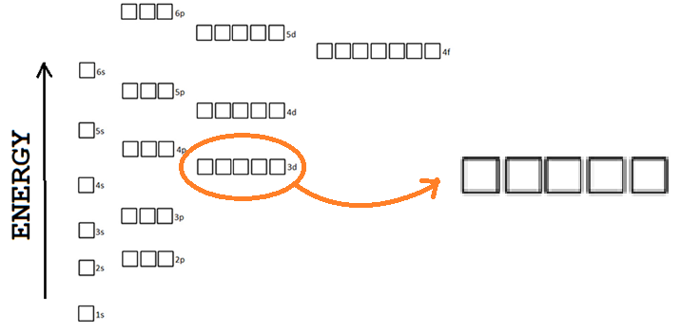
Hund’s rules
The spins align to decrease the Coulomb interaction.

Slide 28
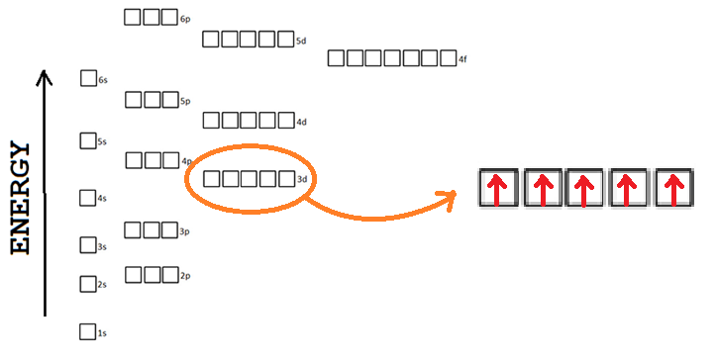
Hund’s rules
The spins align to decrease the Coulomb interaction.

Slide 29
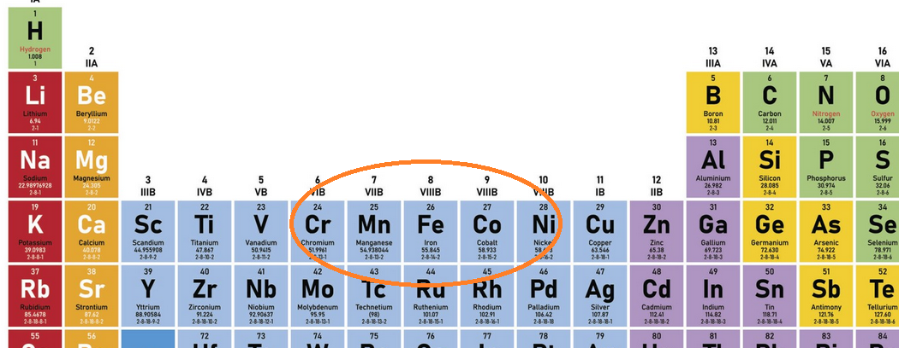
Band magnetism
Narrow bands with high degeneracy (f shell) will have the largest magnetic moment near half-filling: 5 electrons per atom in that shell

Slide 30
Superconductivity
Superconductivity is due to a attractive interaction between electrons that causes them to form pairs.
The pairs have opposite spins, because it makes the wavefunction simpler, and because the Pauli principle isn’t going to force them apart.

Slide 31
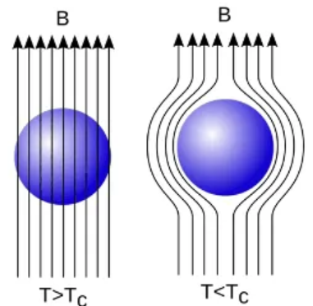
Meissner effect
A magnetic field tries to align the spins, and this would disrupt the pairing. Therefor a current appears on the surface of a superconductor to keep the magnetic field out.

Slide 32
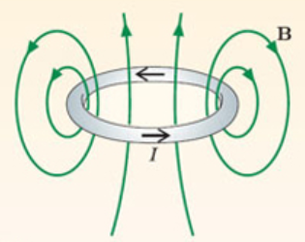
Superconductivity
A closed ring of superconductor traps magnetic flux inside it. The flux can’t escape because of the Meissner effect; the current can’t stop, because of Ampere’s law.

Slide 33
Summary
The theorists claim there are four forces
>> Electromagnetism
>> Strong force
>> Weak force
>> Gravity
But the Pauli exclusion principle is more fundamental than any of them, and plays an important role in establishing the universe we live in.

